Slide 1

Developing a Simple Model-driven DSS
By: Setyo Tri Windras Mara
setyotriw@ugm.ac.id | +6282242605270

Slide 2

Content
When will you need the model-driven DSS?
Illustration: a. Traveling Salesman Problem b. Machine Learning: Classification c. Multi-criteria Decision Making
Form of solver
Implementation: Simulated Annealing for TSP
Your task

Slide 3

When will you need a model-driven DSS?

Slide 4
Prolog
As industrial engineers (either you work on the industry or research), we will face numerous conditions when your cognitive ability is not able to crunch the problem anymore.
Either due to:
The complexity of the problem, or
The frequency of the problem-solving activity itself.
At that moment, you may (or may not?) need a little help.

Slide 5
Some logical illustrations

Slide 6


Traveling Salesman Problem
C
A
B
A
B
Two alternatives
Six alternatives..
Now, what about this?!.
A - B
B - A
A – B - C
A – C – B
B – A – C
B – C – A
C – A – B
C – B – A

Slide 7
Feature Selection in a Classification
V1
V2
V3
V4
These two different sets of feature(s) may lead to different classification accuracy
V1
V2
V3
V4
So, what if now we have some dataset like this..
V1
V2
V3
V4
V5
V6
V7
V8
…
…
V50

Slide 8
Multicriteria Decision Making
Suppose, you wanna buy a football player..
Price
Skill
Loyalty
V1
V2
V3
V15
…
Ronaldo
Player 1
Player 2
Messi
Player 3
Hyuga
.
.
Tsubasa
Player 30

Slide 9
Training time!

Slide 10
Let’s consider a case of TSP..
1
2
5
4
3
All customers have to be visited once, and then returns to the source
The question: “Which route will generate the shortest distance?”

Slide 11
What options we have?
Mathematical model (Mixed-integer linear programming)
Simulation (DES, Agent-based)
Exact Algorithm (Branch-and-bound)
Heuristic Algorithm - Genetic Algorithms (Holland, 1975) - Simulated Annealing (Kirkpatrick et al., 1983) - Particle Swarm Optimization (Kennedy and Eberhart, 1995) - Ant Colony Optimization (Dorigo and Di Caro, 1999) etc.

Slide 12
Simulated Annealing
Mimics the annealing process.
Why simulated annealing? Because this is the easiest algorithm of them all.

Slide 13
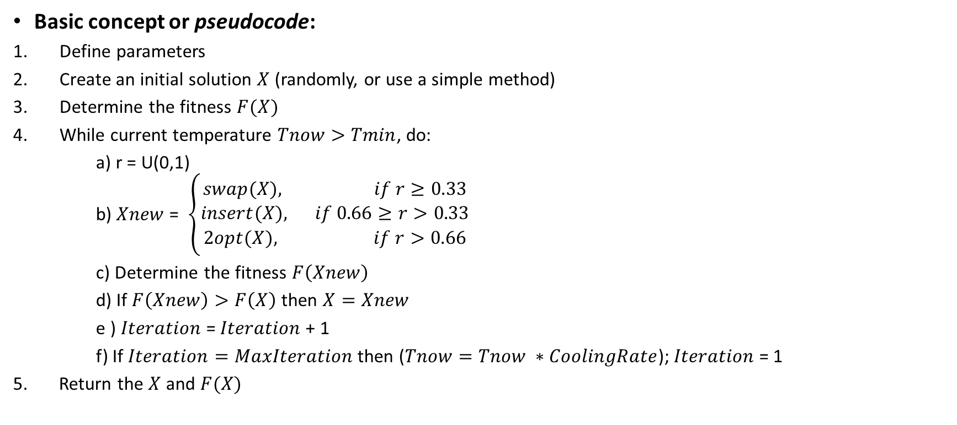


Simulated Annealing framework
Basic concept or pseudocode:
Define parameters
Create an initial solution $X$ (randomly, or use a simple method)
Determine the fitness $F(X)$
While current temperature $Tnow>Tmin$, do:
a) r = U(0,1) b) $Xnew$= $\left\{\begin{aligned}swap(X), if r≥0.33 \\ insert(X), if 0.66≥r>0.33 \\ 2opt(X), if r>0.66\end{aligned}\right.$ c) Determine the fitness $F\left(Xnew\right)$
d) If $F\left(Xnew\right)>F\left(X\right)$ then $X=Xnew$
e ) $Iteration$= $Iteration$+ 1
f) If $Iteration=MaxIteration$ then ($Tnow=Tnow ∗CoolingRate$); $Iteration$= 1
5. Return the $X$ and $F(X)$
Create $Xnew$
“Wanna keep $Xnew$?”
“Update Temperature”

Slide 14




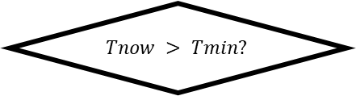

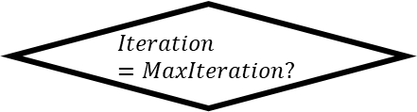
Initial Solution $X$
Calculate $F(X)$
$$Tnow > Tmin?$$
Get the results
No
No
Yes
Create $Xnew$
Calculate $F(Xnew)$
“Wanna keep $Xnew$?”
Iteration = Iteration+1
$$Iteration=MaxIteration?$$
Update Temperature

Slide 15

Put it on the DSS framework
Set of customers
Geographical Data
Geographical Database (GIS)
Your fckn DSS
Simulated Annealing
Routing solution
Objective Value ($F$)

Slide 16

Step 1 – Define parameters
Parameters :
$Tmax=100$
$Tmin=1$
$CoolingRate=0.9$
$MaxIteration=50$
Initialization :
$Tnow=Tmax$
$Iteration=1$

Slide 17

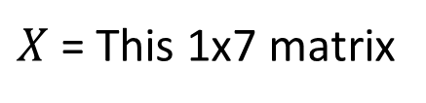

Step 2 – Create Initial Solution
Creating an initial solution $X$, randomly
0
1
2
4
5
3
0
Other options?
Greedy heuristic
Nearest Neighbor heuristic
Solution size ($k$) = 7
$X$ = This 1x7 matrix

Slide 18



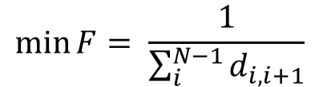
Step 3 – Calculate $F(X)$
Determine the fitness
$$d$$
$$F$$
0
1
2
4
5
3
0
18
0.056
What is the fitness in this context?
$$\min{F}= \frac{1}{\sum_{i}^{N−1}{d_{i,i+1}}}$$
The shorter its distance, the bigger its fitness!

Slide 19


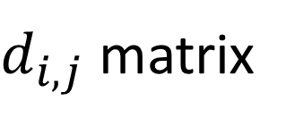
$$j$$
0 1 2 3 4 5
0
1
2
3
4
5
0 7 3 2 7 5
7 0 3 2 6 6
3 3 0 5 3 7
$d_{i,j}$ matrix
$$i$$
2 2 5 0 5 4
7 6 3 5 0 3
5 6 7 4 3 0
Notes:
7+6+3+7+5+2

Slide 20

Step 4 – Iteration a. Create the $Xnew$
Swap (Flip the locations of two nodes)
Insert (Put one node right behind another node)
2opt (a-b-c-d → a-c-b-d)
0
1
2
4
5
3
0
0
5
2
4
1
3
0
0
1
2
4
5
3
0
0
1
4
5
2
3
0
0
1
2
4
5
3
0
0
1
5
4
2
3
0

Slide 21
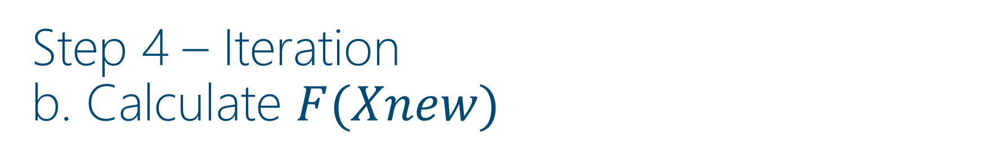




Step 4 – Iteration b. Calculate $F(Xnew)$
Assume that $Xnew=insert(X)$
$$d$$
$$F$$
$$Xnew$$
0
1
4
5
2
3
0
30
0.033

Slide 22


Step 4 – Iteration c. Wanna keep the new solution?
Assume that $Xnew=insert\left(X\right)$
Aw, the new one is shite, lets go back to the old house..
$$X ≠Xnew$$
$$d$$
$$F$$
$$Xnew$$
0
1
4
5
2
3
0
30
0.033
$$X$$
0
1
2
4
5
3
0
18
0.056

Slide 23

Step 4 – Iteration d & e. Update iteration & temperature
$$Iteration = Iteration + 1$$
$$Tnow = Tnow ∗ CoolingRate$$

Slide 24


Step 5 – Return the best solution
$$d$$
$$F$$
0
1
2
4
5
3
0
18
0.056
1
2
5
4
3

Slide 25
Your final task..

Slide 26
Tasks
Kerjakan Soal ke-2 UAS berikut:
2. Develop a simple model-driven DSS for a Traveling Salesman Problem using Genetic Algorithm. (lang: Python)
Solve the given two cases: ‘yk11’ and ‘berlin52’
Provide the code for maps visualization of your results
Provide the code for the fitness value plots
Upload jawaban dalam format .py dengan filename “DSS_Soal2_NIU_NamaAnda” ke Classroom Google (code: 6ygqfbe), atau private chat via WA (hanya bila terjadi error).
Diperbolehkan melakukan konsultasi via WA, dan setiap student WAJIB MENGIRIMKAN PROGRESS 50%-nya KE setyotriw@ugm.ac.id.

Slide 27
Genetic Algorithm

Slide 28
Genetic Algorithm
Mimics the natural selection process.
The more adaptive individual (has a higher ‘fitness’) will persist, the lesser one will die..
Has two important concept:
Crossover / Breeding
Mutation

Slide 29
Genetic Algorithm
Basic concept or pseudocode:
Create a new population
Determine each individual’s fitness
In every iteration, do :
a) Parent selection b) Crossover / Breeding c) Mutation d) Determine the fitness of new population
Stop if the criteria is satisfied
Accept the best solution

Slide 30
Example: Genetic Algorithm
Creating a new population, randomly
1
2
4
5
3
3
2
1
4
5
4
2
1
5
3
Population size : 6 chromosomes
Chromosome size : 5 genes
Iteration size : 100 (arbitrary)
Population size
2
3
1
4
5
5
4
3
2
1
1
2
5
3
4
Chromosome size

Slide 31
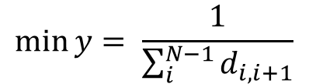


Example: Genetic Algorithm
Determine each individual’s fitness
$$d$$
$$y$$
1
2
4
5
3
4
0.25
3
2
1
4
5
5
0.2
$$\min{y}= \frac{1}{\sum_{i}^{N−1}{d_{i,i+1}}}$$
4
2
1
5
3
3
0.33
2
3
1
4
5
8
0.125
The shorter its distance, the bigger its fitness!
5
4
3
2
1
9
0.11
1
2
5
3
4
9
0.11

Slide 32




Example: Genetic Algorithm
Parent selection by creating a mating pool (ex: Poolsize = 3)
$$y$$
$$chance$$
$$(\%)$$
$$cum.$$
(%)
1
2
4
5
3
0.25
22.2
22.2
Now, we do these steps twice:
Generate a random number (0,100)
Choose a chromosome
5
4
3
2
1
0.2
17.8
40
4
2
1
5
3
0.33
29.3
69.3
Suppose, resulting in this pool of parents :
2
3
1
4
5
0.125
11.1
80.4
1
2
4
5
3
5
4
3
2
1
0.11
9.8
90.2
5
4
3
2
1
1
2
5
3
4
0.11
9.8
100
4
2
1
5
3
$$sum$$
112.5

Slide 33
Example: Genetic Algorithm
Crossover / Breeding (ex: Crossover rate = 0.9)
Since we already have 3 parents in the pool, now, we need to create three childs
Do crossover?
1
2
4
5
3
Yes
5
4
3
2
1
No
5
4
3
2
1
4
2
1
5
3
Yes
Mating pool
Childrens

Slide 34
Example: Genetic Algorithm
Examples of Crossover Technique
Parent 1
1
2
4
5
3
Parent 1
4
2
1
5
3
Parent 2
5
4
3
2
1
Parent 2
5
4
3
2
1
Child
3
2
4
5
1
Child
4
2
3
5
1
Order Crossover
1-Point Crossover

Slide 35
Example: Genetic Algorithm
Mutation (ex: Mutation rate = 0.1)
Do mutation?
1
2
4
5
3
No
1
2
4
5
3
5
4
3
2
1
No
5
4
3
2
1
4
2
1
5
3
No
4
2
1
5
3
3
2
4
5
1
Yes
5
4
3
2
1
No
5
4
3
2
1
4
2
3
5
1
No
4
2
3
5
1

Slide 36
Example: Genetic Algorithm
Examples of Mutation Technique
Before
3
2
4
5
1
Before
3
2
4
5
1
After
3
1
4
5
2
After
3
1
5
4
2
Swap Mutation
Reverse Mutation

Slide 37

TERIMA KASIH

